Slide 1
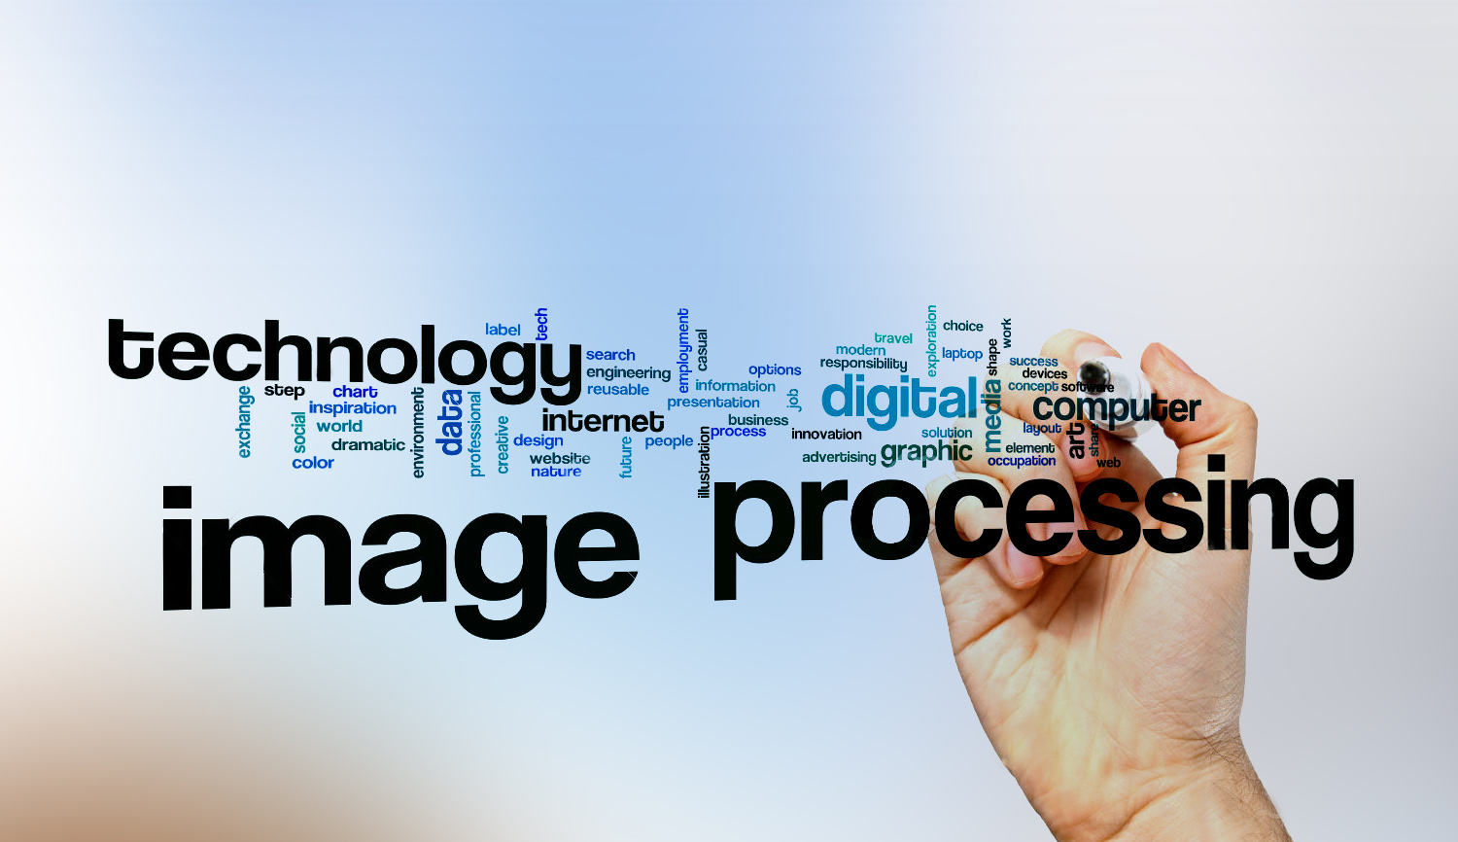
Digital Image Processing
13-Explain the process of sampling and quantization. Explain its importance in DIP
Digitizing an image > to create digital image.
(Importance: To convert a continuous image f (x, y) into digital form)
Sampling > digitizing of space
Quantization > digitizing of intensity of color (determine how many different colors image can have)

Slide 2
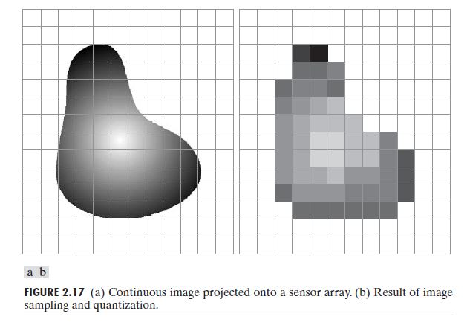
Digital Image Processing
13-Explain the process of sampling and quantization. Explain its importance in DIP

